Slide 1
CSE 460: VLSI Design (Lab)
Experiment 3
Simulation of Mealy and Moore Type FSMs in Verilog

Slide 2

Finite State Machine
In Combinational logic circuits, outputs are determined solely by the present values of the inputs.
In Sequential circuits, outputs depend both on the past behavior of the circuit and the present values of the inputs. The storage elements in terms of flip-flops can reserve the state information of the logic circuit at any given time.
The sequential circuits in which a clock signal is used to control the operation of the circuit, is called synchronous sequential circuits. These synchronous sequential circuits are known in general as Finite State Machines (FSMs).
The building blocks of a finite state machine are combinational circuits and one or more flip-flops. Under the control of the clock signal, the flip-flops change their state as determined by the combinational logic.
Combinational
circuit
Flip-flops
Combinational
circuit
W
Q
Z
Clock

Slide 3
Finite State Machine
FSMs can be of two types:
Moore type FSM
The sequential circuits whose outputs depend only on the states of the circuit are of Moore type.
Mealy type FSM
The sequential circuits whose outputs depend on both the state and the present primary inputs are of Mealy type
Combinational
circuit
Flip-flops
Combinational
circuit
W
Q
Z
Clock

Slide 4
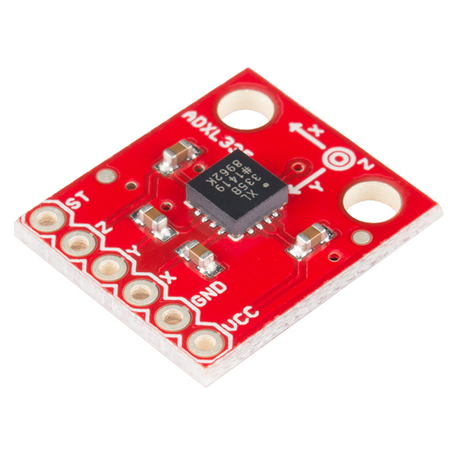
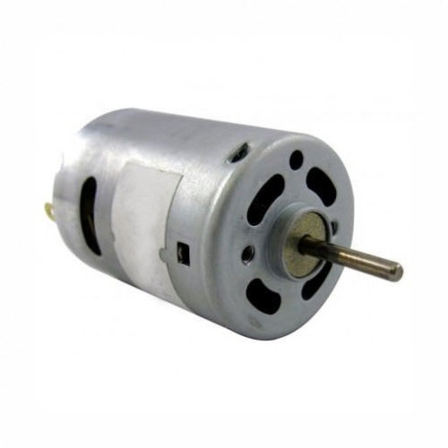
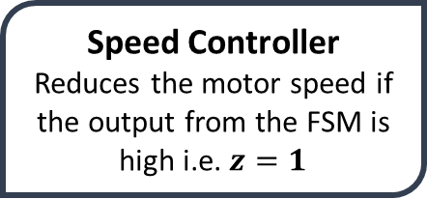

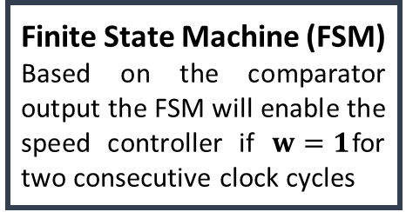
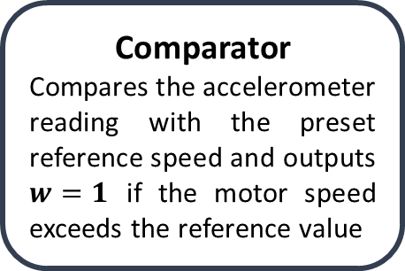
FSM based motor speed controller
Accelerometer
Comparator
Compares the accelerometer reading with the preset reference speed and outputs $w=1$ if the motor speed exceeds the reference value
Motor speed
(rpm)
w
DC motor
$$500 rpm$$
Finite State Machine (FSM)
Based on the comparator output the FSM will enable the speed controller if $w=1$for two consecutive clock cycles
Speed Controller
Reduces the motor speed if the output from the FSM is high i.e. $z=1$
z

Slide 5
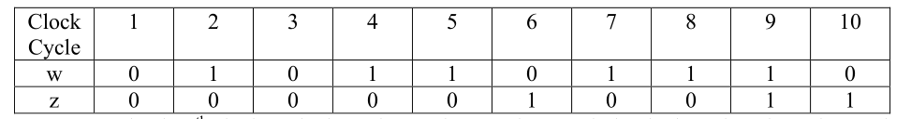
Moore Type FSM
Problem:
Suppose that we wish to design a circuit that meets the following specification:
The circuit has one input, w, and one output, z.
All changes in the circuit occur on the positive edge of a clock signal.
The output z is equal to 1 if during two immediately preceding clock cycles the input w was equal to 1. Otherwise, the value of z is equal to 0.
Input-output combination:

Slide 6

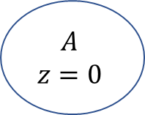

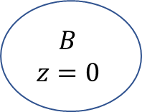



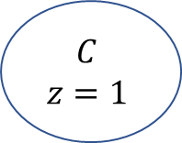

Moore Type FSM
Reset
$$w=1$$
$$A$$
$$z=0$$
$$B$$
$$z=0$$
$$w=0$$
Present State | Next State |  | Output z
 | w=0 | w=1
A | A | B | 0
B | A | C | 0
C | A | C | 1
$$w=0$$
$$w=1$$
$$w=0$$
$$C$$
$$z=1$$
Figure : State Table
$$w=1$$
Figure : State Diagram

Slide 7
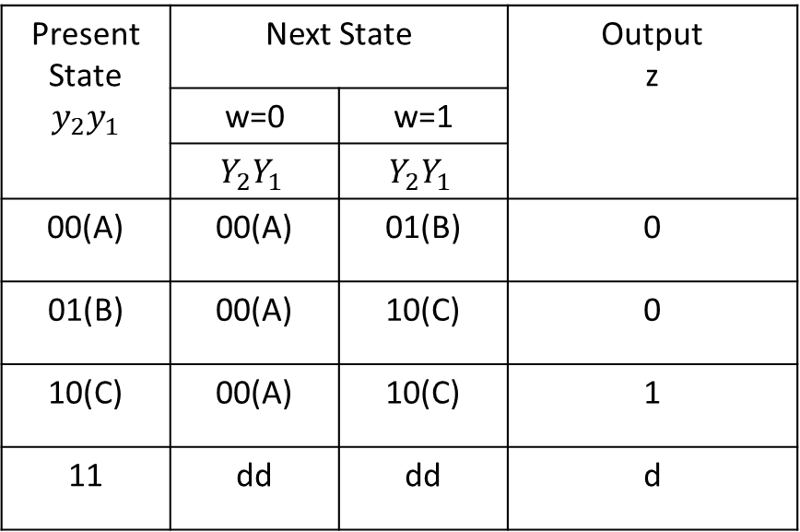
Moore Type FSM
Reset
$$w=1$$
$$A$$
$$z=0$$
$$B$$
$$z=0$$
Present State $$y_{2}y_{1}$$ | Next State |  | Output z
 | w=0 | w=1
 | $$Y_{2}Y_{1}$$ | $$Y_{2}Y_{1}$$
00(A) | 00(A) | 01(B) | 0
01(B) | 00(A) | 10(C) | 0
10(C) | 00(A) | 10(C) | 1
11 | dd | dd | d
$$w=0$$
$$w=0$$
$$w=1$$
$$w=0$$
$$C$$
$$z=1$$
$$w=1$$
Figure : State Diagram

Slide 8



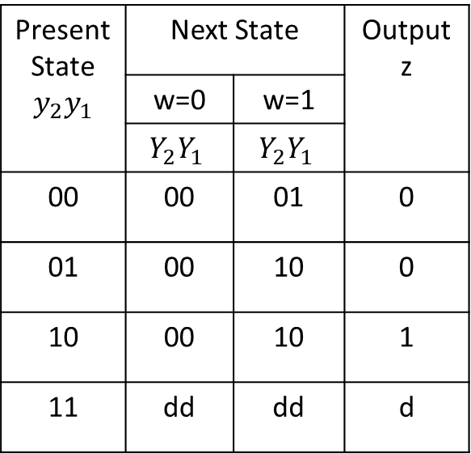



General Circuit Diagram of the FSM
$$Y_{1}$$
$$y_{1}$$
Combinational
circuit
FF-1
Combinational
circuit
Present State $$y_{2}y_{1}$$ | Next State |  | Output z
 | w=0 | w=1
 | $$Y_{2}Y_{1}$$ | $$Y_{2}Y_{1}$$
00 | 00 | 01 | 0
01 | 00 | 10 | 0
10 | 00 | 10 | 1
11 | dd | dd | d
$$w$$
$$z$$
$$Y_{2}$$
$$y_{2}$$
FF-2
Clock

Slide 9







Designing the FSM in Verilog
Combinational circuit synthesis in Verilog
always@(*)blocks are used to describe combinational logic in Verilog. Blocking assignment statements are to be used inside these blocks.
always@(*)
begin
C = A & B;
end
In order to design the FSM using Verilog we will need to perform the following steps:
Assigning binary variables to states
A mechanism for figuring out the current state (Sequential circuit block)
Defining the logic for state transition (Combinational circuit block)
Defining the output for the current state (Continuous assignment statement)
$$A$$
$$C$$
$$B$$
Sequential circuit synthesis in Verilog
always@(posedge clk) or always@(negedge clk) blocks are used to describe combinational logic in Verilog. Non-blocking assignment statements are to be used inside these blocks.
always@(posedge clk) begin
Q <= D;
end
FF
$$Q$$
$$D$$
$$clk$$
$$\overline{Q}$$

Slide 10
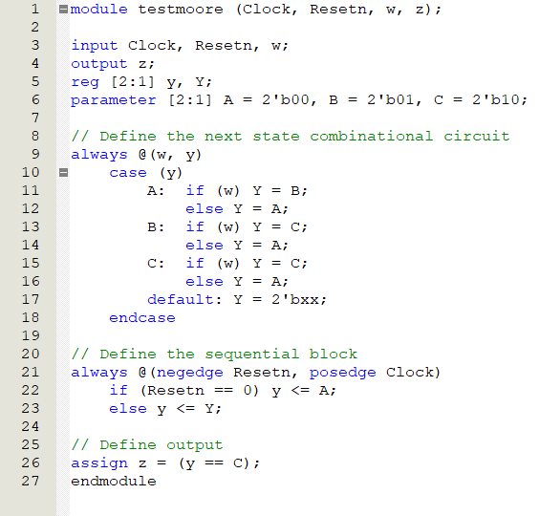
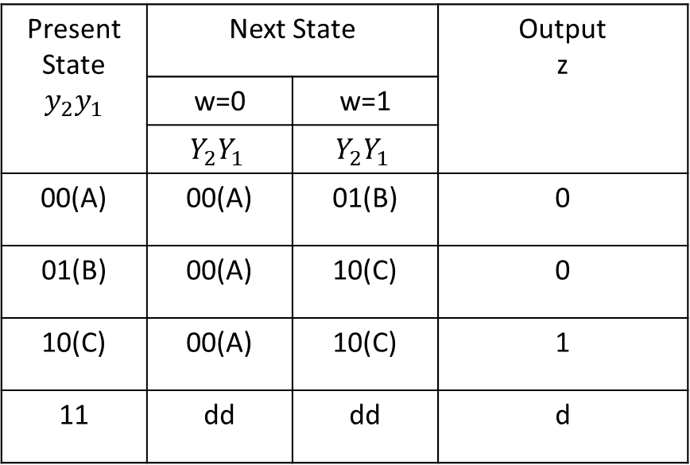
Moore Type FSM
Present State $$y_{2}y_{1}$$ | Next State |  | Output z
 | w=0 | w=1
 | $$Y_{2}Y_{1}$$ | $$Y_{2}Y_{1}$$
00(A) | 00(A) | 01(B) | 0
01(B) | 00(A) | 10(C) | 0
10(C) | 00(A) | 10(C) | 1
11 | dd | dd | d

Slide 11
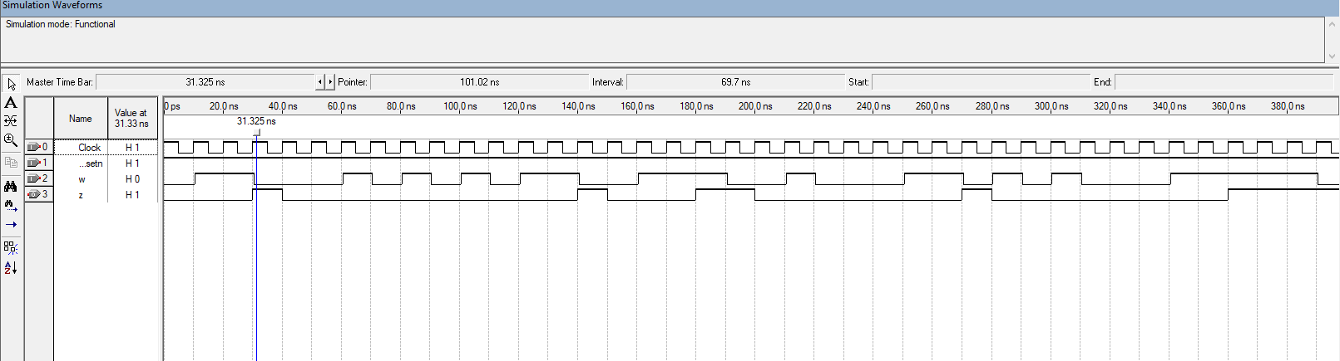
Moore Type FSM

Slide 12
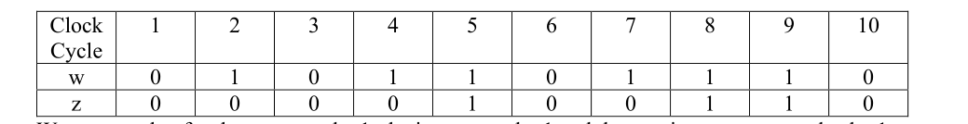
Mealy Type FSM
Problem:
We wish to design a circuit that meets the following specification:
The circuit has one input, w, and one output, z.
All changes in the circuit occur on the positive edge of a clock signal.
The output z is equal to 1 if during two immediate clock cycles the input w was equal to 1. Otherwise, the value of z is equal to 0.
Input-output combination:

Slide 13

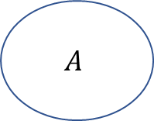



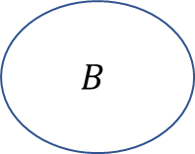
Mealy Type FSM
Reset
$w=1$ / $z=0$
Present State | Next State |  | Output z
 | w=0 | w=1 | w=0 | w=1
A | A | B | 0 | 0
B | A | B | 0 | 1
$$A$$
$$B$$
$w=0$ / $z=0$
$w=1$ / $z=1$
$w=0$ / $z=0$
Figure : State Table
Figure : State Diagram

Slide 14
Mealy Type FSM
Present State | Next State |  | Output z
 | w=0 | w=1 | w=0 | w=1
A | A | B | 0 | 0
B | A | B | 0 | 1
Present State | Next State |  | Output z
y
 | w=0 | w=1 | w=0 | w=1
 | Y | Y
0(A) | 0(A) | 1(B) | 0 | 0
1(B) | 0(A) | 1(B) | 0 | 1
Figure : State Table
Figure : State-assigned Table

Slide 15
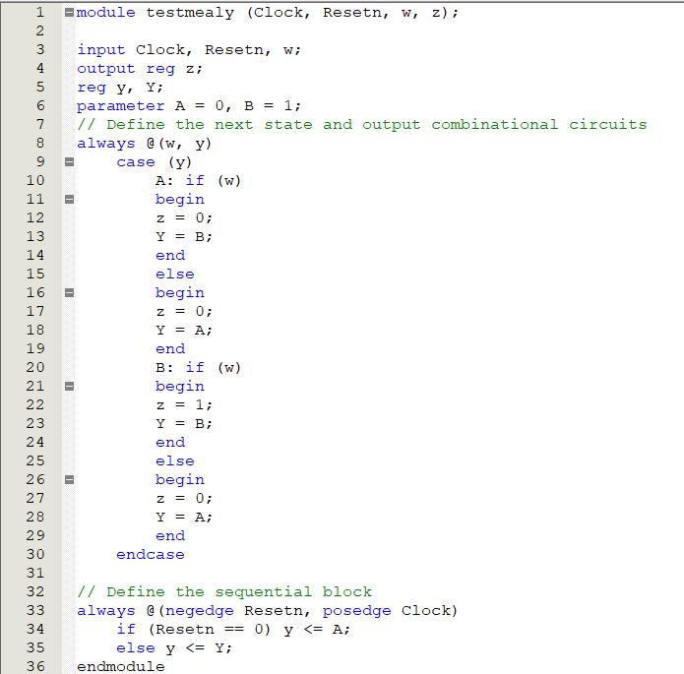
Mealy Type FSM
Present State | Next State |  | Output z
y
 | w=0 | w=1 | w=0 | w=1
 | Y | Y
0(A) | 0(A) | 1(B) | 0 | 0
1(B) | 0(A) | 1(B) | 0 | 1

Slide 16
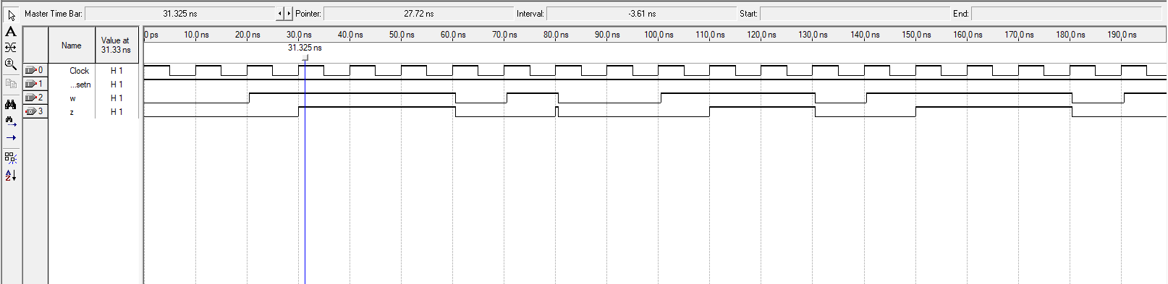
Mealy Type FSM

Slide 17
An Example
Problem: Derive the state diagram for an FSM that has an input w and an output z. The machine has to generate z = 1 when the previous four values of w were 1001 or 1111; otherwise, z = 0.Overlapping input patterns are allowed. An example of the desired behavior is
Clock cycle | 1 | 2 | 3 | 4 | 5 | 6 | 7 | 8 | 9 | 10 | 11 | 12 | 13 | 14 | 15 | 16 | 17
w | 0 | 1 | 0 | 1 | 1 | 1 | 1 | 0 | 0 | 1 | 1 | 0 | 0 | 1 | 1 | 1 | 1
z | 0 | 0 | 0 | 0 | 0 | 0 | 0 | 1 | 0 | 0 | 1 | 0 | 0 | 0 | 1 | 0 | 0

Slide 18
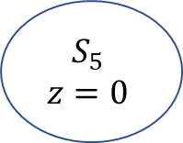





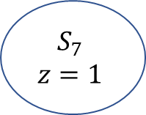





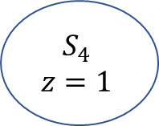









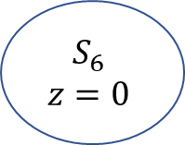



State diagram(Moore type)
$$1111$$
Reset
$$S_{0}$$
$$z=0$$
$$w=1$$
$$S_{1}$$
$$z=0$$
$$w=1$$
$$S_{2}$$
$$z=0$$
$$w=1$$
$$S_{3}$$
$$z=0$$
$$w=1$$
$$S_{4}$$
$$z=1$$
$$w=1$$
$$w=0$$
$$w=1$$
$$w=0$$
$$S_{5}$$
$$z=0$$
$$w=0$$
$$w=0$$
$$w=0$$
$$w=0$$
$$w=0$$
$$S_{6}$$
$$z=0$$
$$w=0$$
$$w=1$$
$$w=1$$
$$S_{7}$$
$$z=1$$
$$1001$$

Slide 19
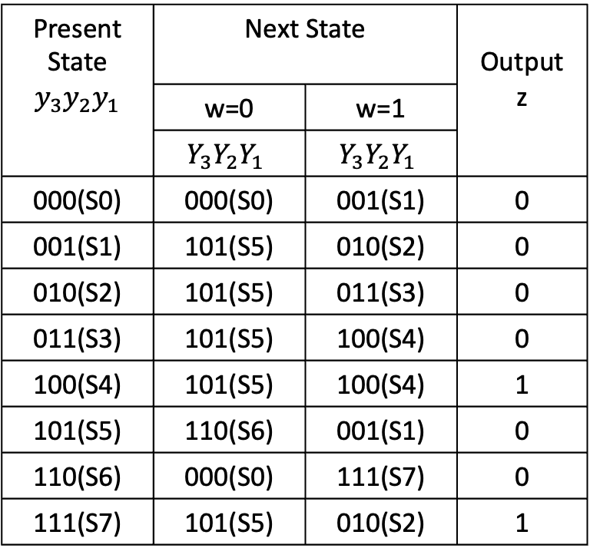
State table (Moore type)
Present State | Next State |  | Output z
 | w=0 | w=1
S0 | S0 | S1 | 0
S1 | S5 | S2 | 0
S2 | S5 | S3 | 0
S3 | S5 | S4 | 0
S4 | S5 | S4 | 1
S5 | S6 | S1 | 0
S6 | S0 | S7 | 0
S7 | S5 | S2 | 1
Present State $$y_{3}y_{2}y_{1}$$ | Next State |  | Output z
 | w=0 | w=1
 | $$Y_{3}Y_{2}Y_{1}$$ | $$Y_{3}Y_{2}Y_{1}$$
000(S0) | 000(S0) | 001(S1) | 0
001(S1) | 101(S5) | 010(S2) | 0
010(S2) | 101(S5) | 011(S3) | 0
011(S3) | 101(S5) | 100(S4) | 0
100(S4) | 101(S5) | 100(S4) | 1
101(S5) | 110(S6) | 001(S1) | 0
110(S6) | 000(S0) | 111(S7) | 0
111(S7) | 101(S5) | 010(S2) | 1
Figure : State Table
Figure : State-assigned Table

Slide 20
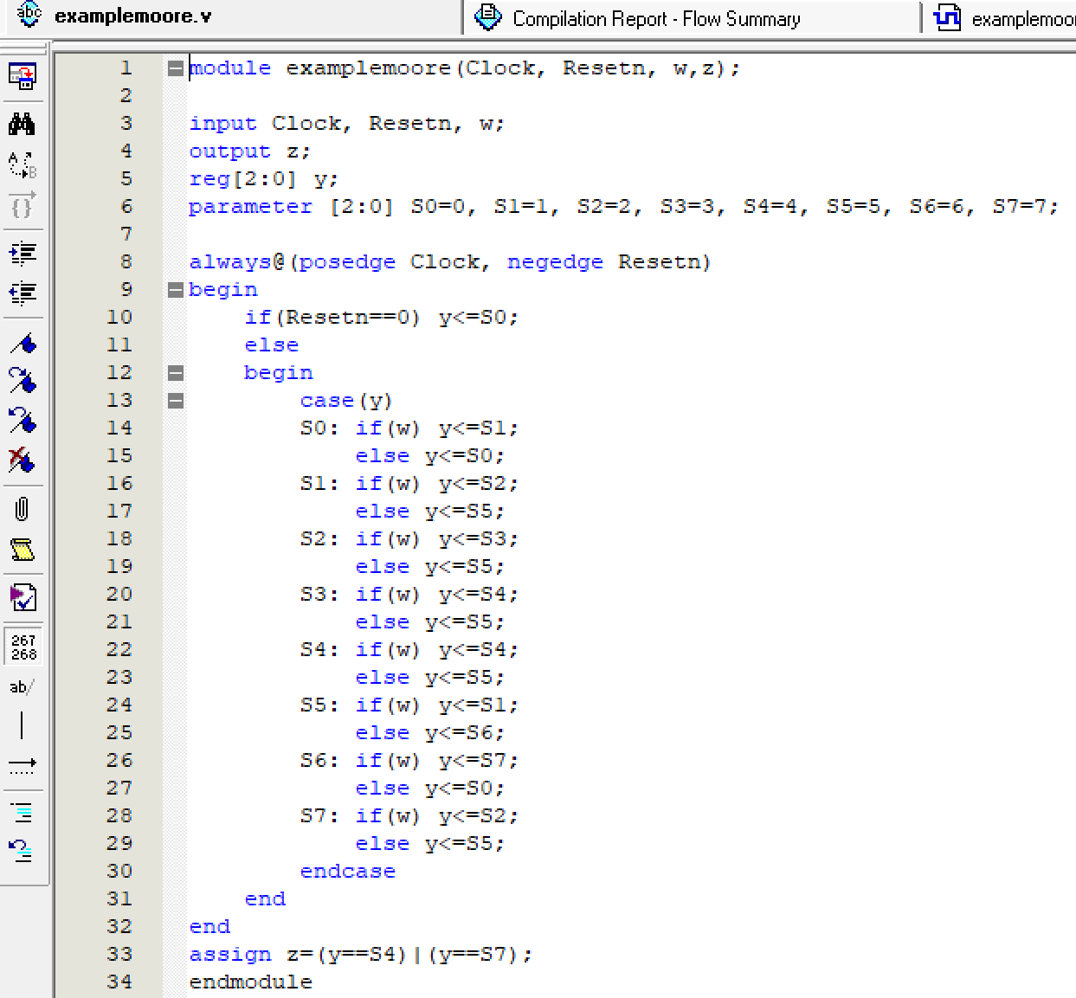
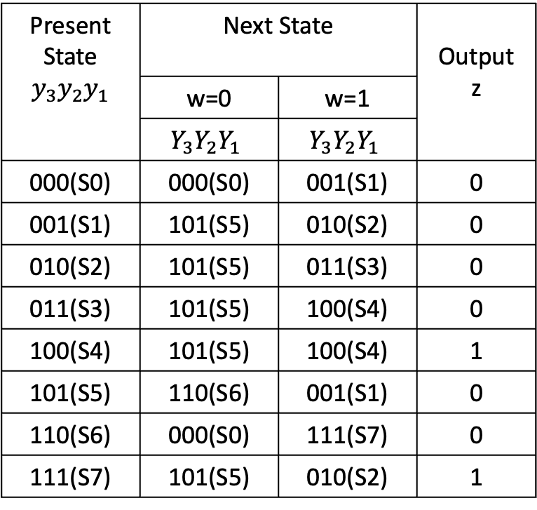
State assigned table (Moore Type)
Present State $$y_{3}y_{2}y_{1}$$ | Next State |  | Output z
 | w=0 | w=1
 | $$Y_{3}Y_{2}Y_{1}$$ | $$Y_{3}Y_{2}Y_{1}$$
000(S0) | 000(S0) | 001(S1) | 0
001(S1) | 101(S5) | 010(S2) | 0
010(S2) | 101(S5) | 011(S3) | 0
011(S3) | 101(S5) | 100(S4) | 0
100(S4) | 101(S5) | 100(S4) | 1
101(S5) | 110(S6) | 001(S1) | 0
110(S6) | 000(S0) | 111(S7) | 0
111(S7) | 101(S5) | 010(S2) | 1

Slide 21
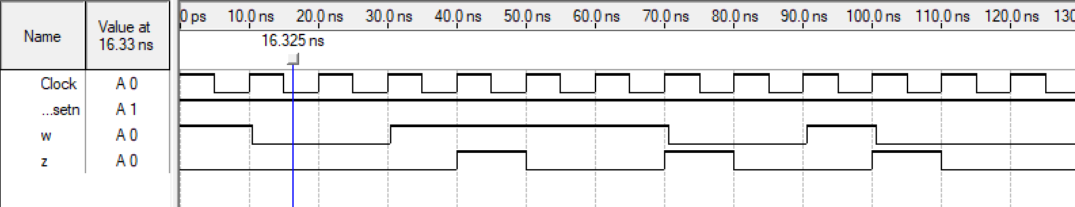
Timing diagrams (Moore Type)
Figure : Output waveform

Slide 22

An Example
Problem: Derive the state diagram of the Mealy version for the example FSM that is, the FSM will generate $z=1$ at the instant the input values of $w$ have the pattern $1111$ or $1001$. Overlapping of the input patterns are allowed.
Clock cycle | 1 | 2 | 3 | 4 | 5 | 6 | 7 | 8 | 9 | 10 | 11 | 12 | 13 | 14 | 15 | 16 | 17
w | 0 | 1 | 0 | 1 | 1 | 1 | 1 | 0 | 0 | 1 | 1 | 0 | 0 | 1 | 1 | 1 | 1
z | 0 | 0 | 0 | 0 | 0 | 0 | 1 | 0 | 0 | 1 | 0 | 0 | 0 | 1 | 0 | 0 | 1

Slide 23



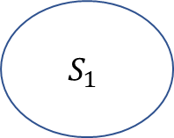






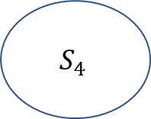

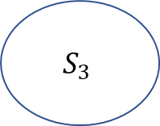


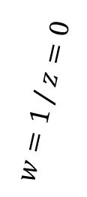



State diagram(Mealy type)
$$1111$$
Reset
$w=1$ / $z=0$
$w=1$ / $z=0$
$w=1$ / $z=0$
$w=0$ / $z=0$
$w=1$ / $z=1$
$$S_{0}$$
$$S_{1}$$
$$S_{2}$$
$$S_{3}$$
$w=1$ / $z=0$
$w=0$ / $z=0$
$w=1$ / $z=1$
$w=0$ / $z=0$
$$S_{4}$$
$w=0$ / $z=0$
$w=0$ / $z=0$
$w=0$ / $z=0$
$$S_{5}$$
$$1001$$

Slide 24
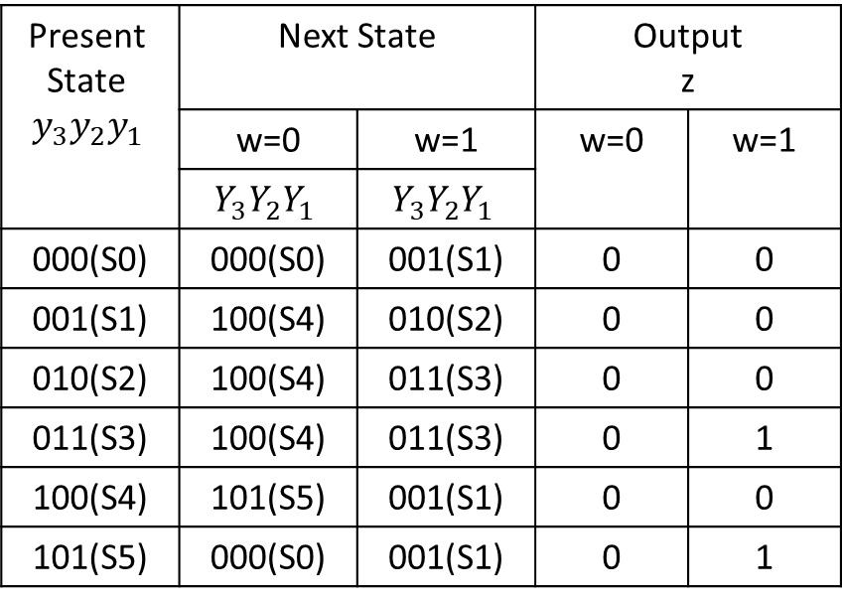
State table (Mealy type)
Present State | Next State |  | Output z
 | w=0 | w=1 | w=0 | w=1
S0 | S0 | S1 | 0 | 0
S1 | S4 | S2 | 0 | 0
S2 | S4 | S3 | 0 | 0
S3 | S4 | S3 | 0 | 1
S4 | S5 | S1 | 0 | 0
S5 | S0 | S1 | 0 | 1
Present State $$y_{3}y_{2}y_{1}$$ | Next State |  | Output z
 | w=0 | w=1 | w=0 | w=1
 | $$Y_{3}Y_{2}Y_{1}$$ | $$Y_{3}Y_{2}Y_{1}$$
000(S0) | 000(S0) | 001(S1) | 0 | 0
001(S1) | 100(S4) | 010(S2) | 0 | 0
010(S2) | 100(S4) | 011(S3) | 0 | 0
011(S3) | 100(S4) | 011(S3) | 0 | 1
100(S4) | 101(S5) | 001(S1) | 0 | 0
101(S5) | 000(S0) | 001(S1) | 0 | 1
Figure : State Table
Figure : State-assigned Table

Slide 25
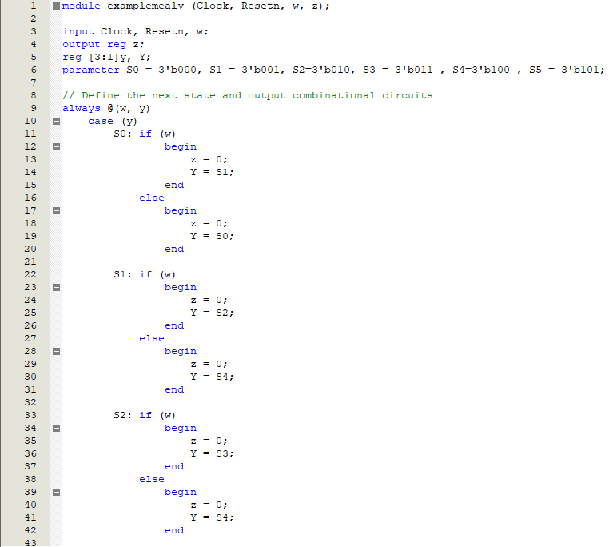
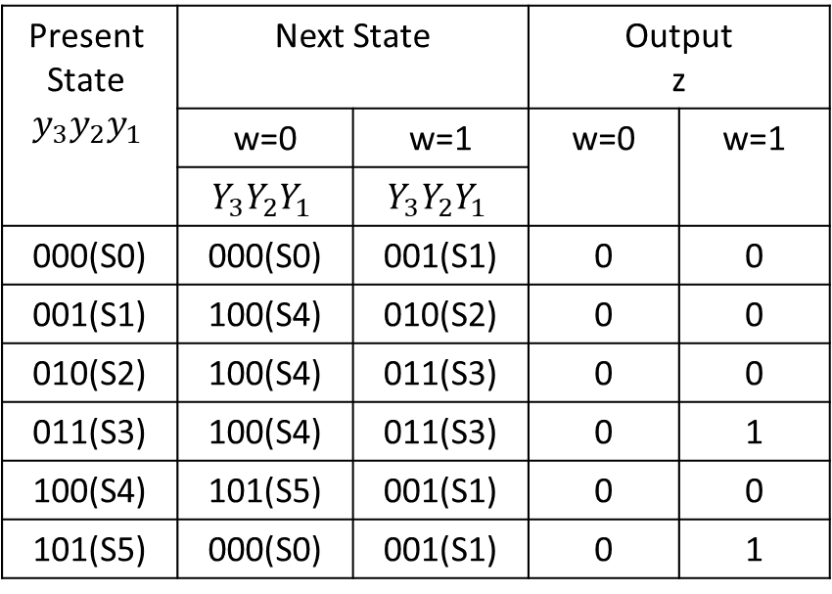
State assigned table (Mealy type)
Present State $$y_{3}y_{2}y_{1}$$ | Next State |  | Output z
 | w=0 | w=1 | w=0 | w=1
 | $$Y_{3}Y_{2}Y_{1}$$ | $$Y_{3}Y_{2}Y_{1}$$
000(S0) | 000(S0) | 001(S1) | 0 | 0
001(S1) | 100(S4) | 010(S2) | 0 | 0
010(S2) | 100(S4) | 011(S3) | 0 | 0
011(S3) | 100(S4) | 011(S3) | 0 | 1
100(S4) | 101(S5) | 001(S1) | 0 | 0
101(S5) | 000(S0) | 001(S1) | 0 | 1
Figure : Verilog code (part 1)
Figure : State-assigned Table
Figure : State-assigned Table

Slide 26
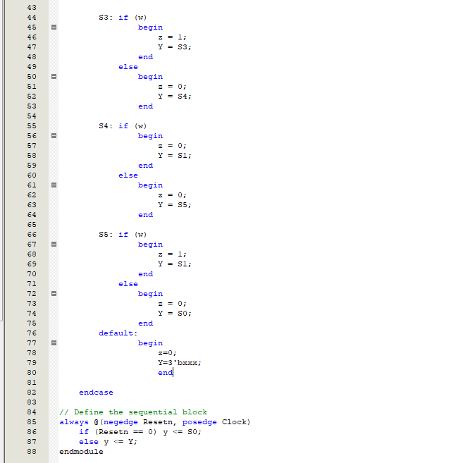
State assigned table (Mealy type)
Present State $$y_{3}y_{2}y_{1}$$ | Next State |  | Output z
 | w=0 | w=1 | w=0 | w=1
 | $$Y_{3}Y_{2}Y_{1}$$ | $$Y_{3}Y_{2}Y_{1}$$
000(S0) | 000(S0) | 001(S1) | 0 | 0
001(S1) | 100(S4) | 010(S2) | 0 | 0
010(S2) | 100(S4) | 011(S3) | 0 | 0
011(S3) | 100(S4) | 011(S3) | 0 | 1
100(S4) | 101(S5) | 001(S1) | 0 | 0
101(S5) | 000(S0) | 001(S1) | 0 | 1
Figure : Verilog code (part 2)
Figure : State-assigned Table

Slide 27
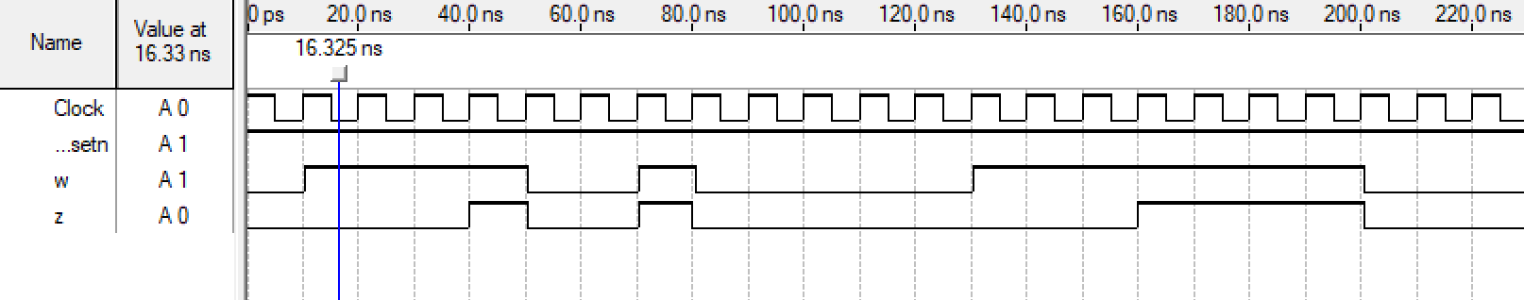
Timing diagrams (Mealy Type)
Figure : Output waveform

